Slide 1
Evaluating Failure Modes in Open-Vocabulary 3D Scene
Understanding
Senior Capstone Project
Oliver Hatta Jones
Oh2087

Slide 2
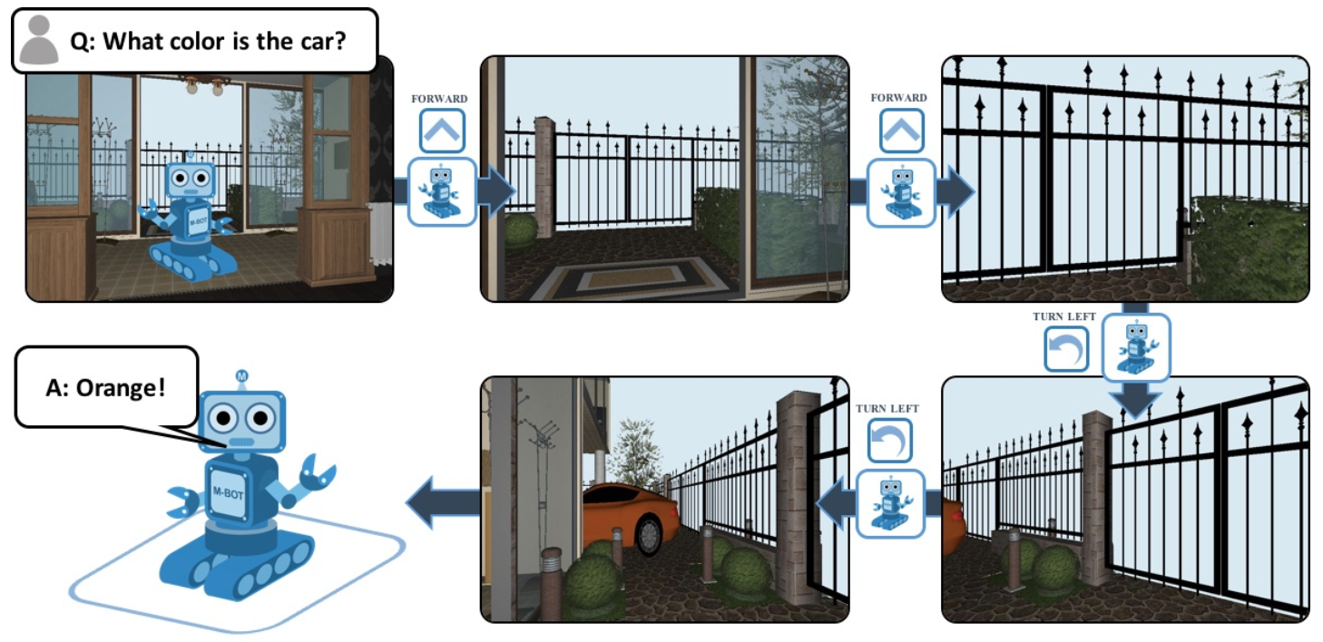
Motivations
Embodied Question Answering (EQA) is different than regular visual querying, as typically an agent will be set up inside of a simulated or real world scene, where the agent needs to gather observations over time, and then answer questions using what it has seen. EQA is an important aspect of robotics, and physical AI, as it is a helpful evaluation tool to gain insights to how embodied agents understanding of said scenes.
Adapted from: https://embodiedqa.org/

Slide 3
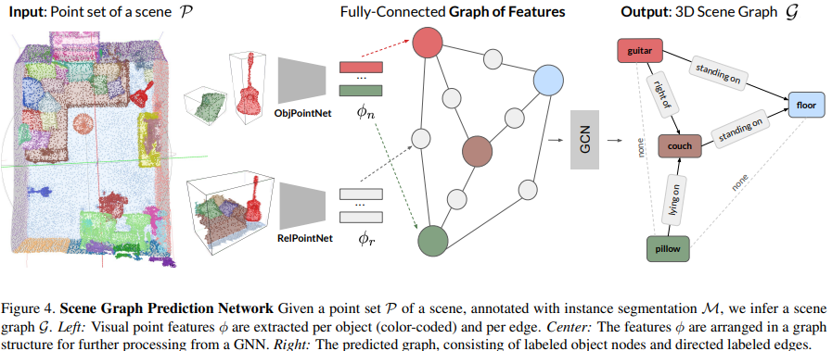
Related Works
Adapted from: Wald, J. et al. (2020). Learning 3D Semantic Scene Graphs from 3D Indoor Reconstructions. CVPR 2020.
3D Gaussian Scene Representation
Scene Graphs
Topological Memory
Represents the environment as a dense 3D set of Gaussian primitives. Each Gaussian stores position, appearance, geometry, and learned semantic features. Observations from multiple viewpoints are fused into this continuous 3D representation
Represents the environment as objects and their relationships. Nodes represent semantic entities such as chairs, tables, and rooms, while edges encode semantic or spatial relationships.
Similar to Scene Graphs, topological memory represents the environment as a graph of places, regions, or visual segments. Nodes represent locations or observations, while edges represent connectivity or possible movement between them.

Slide 4
Related Works: OpenEQA
Episodic-Memory EQA (EM-EQA)
  Agent has already explored the environment.
  Receives a question plus recorded observations from the trajectory.
  Must answer using only previously collected visual/spatial information.
Active EQA (A-EQA)
  Agent receives a question before or during exploration.
  Can actively navigate to gather missing information.
  Must decide where to move and what to observe before answering.
EM-EQA tests memory quality and scene representation.
A-EQA tests both exploration strategy and question answering.

Slide 5
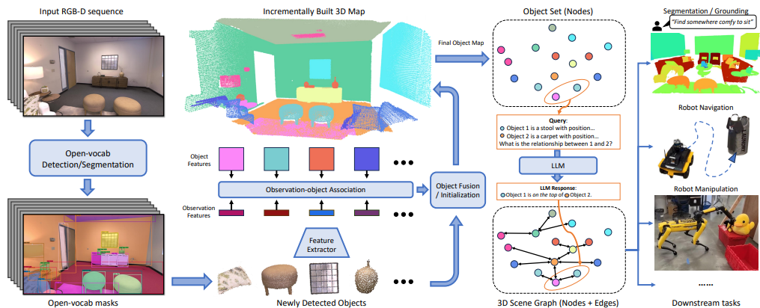
Related Works: Concept Graphs
Concept graphs will serve as the primary baseline for this research project.
Authors here point out that 3D scene graphs are good at efficiently describing scenes using objects and edges
The final graph depends on several construction stages. Errors in detection, multi-view association, object merging, or relationship generation can change what information is available to downstream queries.

Slide 6
Related Works
Scene Graphs
Other Memories
Object nodes can carry flexible semantic labels instead of relying only on a fixed class set.
Stores objects and relations rather than dense geometry or all visual features.
Nodes and edges make the representation easy to inspect and use for planning or VLM reasoning.
Weakness: abstraction can lose geometric or visual detail, and construction errors can propagate into the graph.
3D Gaussian Memory: Denser and more computationally expensive; semantic objects and relationships are embedded in continuous features, making direct lookup and reasoning harder.
Topological Maps: Lightweight and effective for navigation, but mainly represent places and connectivity rather than detailed object identities and semantic relationships.

Slide 7
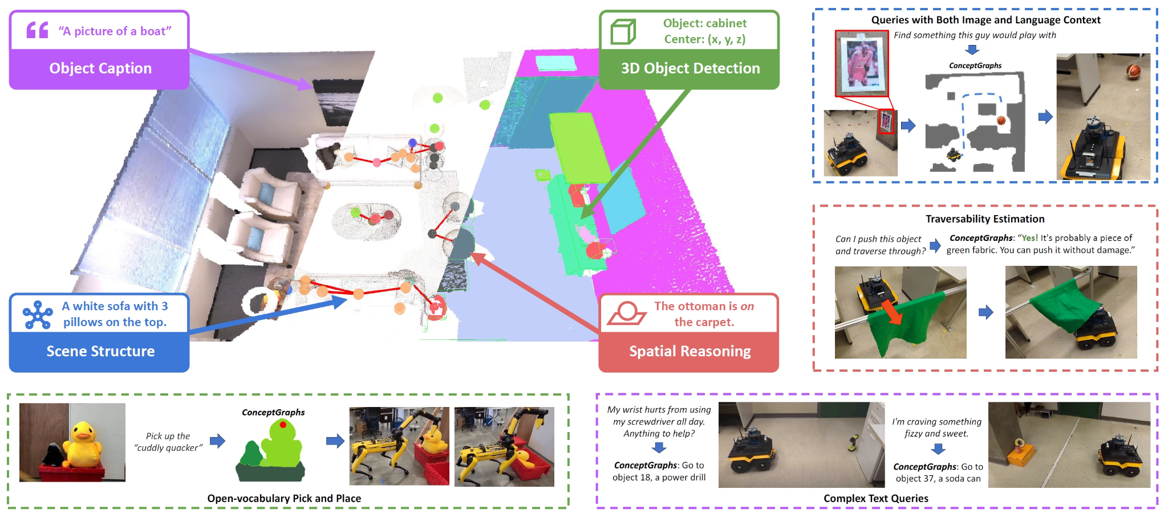
Updated Objectives
Failure analysis of Concept Graphs scene construction
Study how sequential RGB-D + 6-DoF observations become object nodes and relationships.
Identify failures in detection, multi-view association, object merging/splitting, localization, and edge construction.
Determine what semantic/spatial information is lost during graph construction.
Measure how construction failures affect querying
Design queries that depend on objects and relationships in the constructed graph.
Relate specific construction errors to downstream scene-understanding failures.
Photos adapted from: Gu, Q. et al. (2023). ConceptGraphs: Open-Vocabulary 3D Scene Graphs for Perception and Planning. arXiv:2309.16650.

Slide 8
Thank you for listening

